Slide 1
Generate Waveform by MATLAB 5G Toolbox
Speaker: Bo-Ting Yeh
Advisor: Prof. Tzi-Dar Chiueh
Date: 2022/10/12

Slide 2
Outline
Transmitter: Generate 5G NR Waveform
Channel: AWGN Channel
Receiver
LEO Channel Model

Slide 3
TX: Generate 5G NR Waveform (1/4)
Set carrier configuration parameters (don’t modified)
nrb: Number of resource blocks
NSizeGrid: Number of resource blocks in the carrier resource grid.
More details about nrCarrierConfig: https://www.mathworks.com/help/5g/ref/nrcarrierconfig.html?searchHighlight=nrCarrierConfig&s_tid=srchtitle_nrCarrierConfig_1

Slide 4
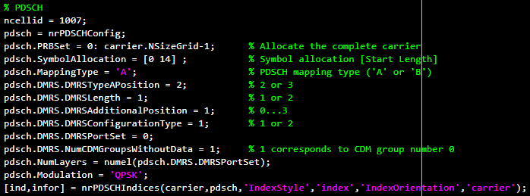
TX: Generate 5G NR Waveform (2/4)
PDSCH configuration parameters (don’t modified)
PDSCH: Physical Downlink Shared Channel
DMRS: DeModulation Reference Signal
More details about nrPDSCHConfig: https://www.mathworks.com/help/5g/ref/nrpdschconfig.html?searchHighlight=nrPDSCHConfig&s_tid=srchtitle_nrPDSCHConfig_1

Slide 5


TX: Generate 5G NR Waveform (3/4)
Generate random bit stream.
Generate modulated symbols.
QPSK or 16QAM
More details about nrSymbolModulate: https://www.mathworks.com/help/5g/ref/nrsymbolmodulate.html?s_tid=doc_ta

Slide 6

TX: Generate 5G NR Waveform (4/4)
Generate time-frequency grid.
Put the modulated symbols on the grid.
Perform OFDM modulation
More details about nrOFDMModulate: https://www.mathworks.com/help/5g/ref/nrofdmmodulate.html?searchHighlight=nrOFDMModulate&s_tid=srchtitle_nrOFDMModulate_1

Slide 7

Channel: AWGN Channel
AWGN channel.
SNR value can be changed.
AWGN channel only add noise. We can change to other fading channel in the future.

Slide 8
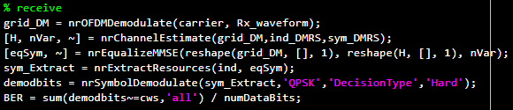
Receiver (1/2)
OFDM demodulation
Channel estimation
MMSE equalization
Symbol demodulation
Calculate BER

Slide 9
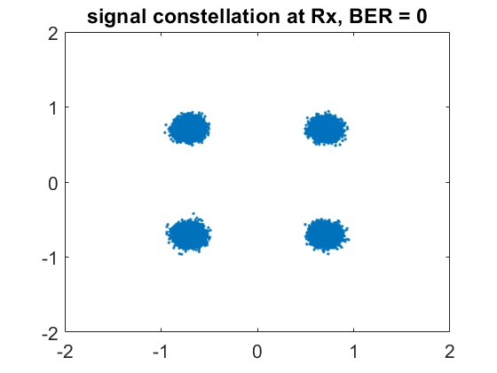
Receiver (2/2)
Received signal constellation after equalization.

Slide 10
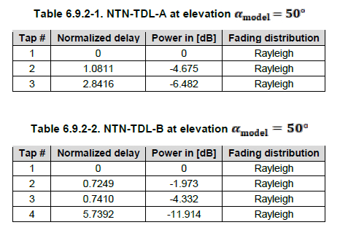
LEO Channel Model (1/6)
Use the delay and power delay profile(PDP) values provided by 3GPP channel model[2].
[2] 3GPP TR 38.811, “Study on New Radio (NR) to support non-terrestrial networks,”

Slide 11
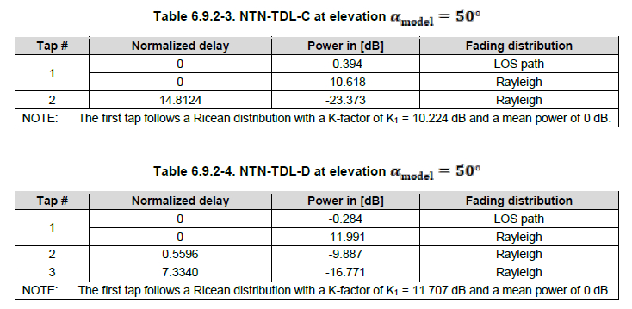
LEO Channel Model (2/6)
Use the delay and power delay profile(PDP) values provided by 3GPP channel model[2].
[2] 3GPP TR 38.811, “Study on New Radio (NR) to support non-terrestrial networks,”

Slide 12
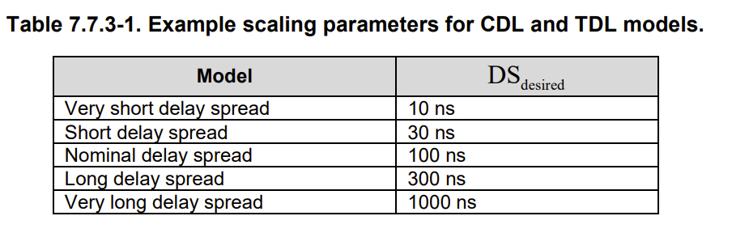
LEO Channel Model (3/6)
The normalized delay value in above table must multiply delay spread to become real delay time.
We choose 30 ns for delay spread[3].
[3] Amit Sravan Bora, et. al. “Spatially Correlated MIMO-OTFS for LEO Satellite Communication Systems”, 2022 ICC Workshops, July 2022.

Slide 13

LEO Channel Model (4/6)
The Doppler shift value of each path is generated randomly using from Jakes’ formula.
$$v_{i}=v_{max}cos(θ_{i})$$
where $v_{max}$ is the maximum Doppler shift obtained by
$v_{max}=max. moving speed∗\frac{f_{c}}{speed of light}$
and $θ_{i}$ is uniformly distributed over [-π, π].

Slide 14
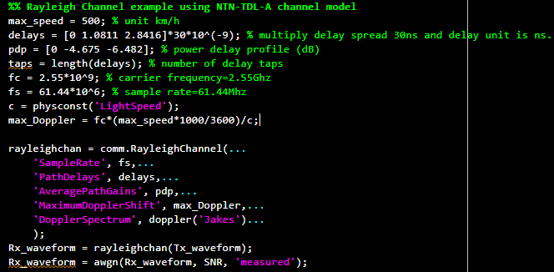
LEO Channel Model (5/6)
Use MATLAB Rayleigh channel.

Slide 15
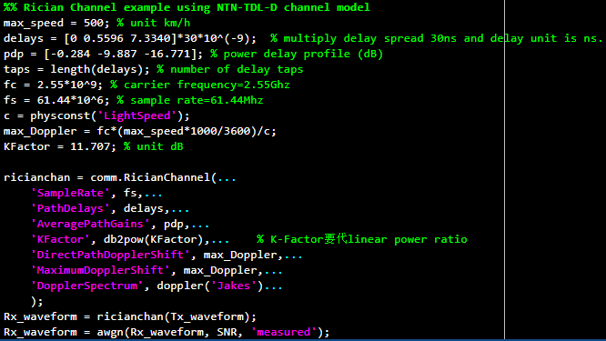
LEO Channel Model (6/6)
Use MATLAB Rician channel.

Slide 16
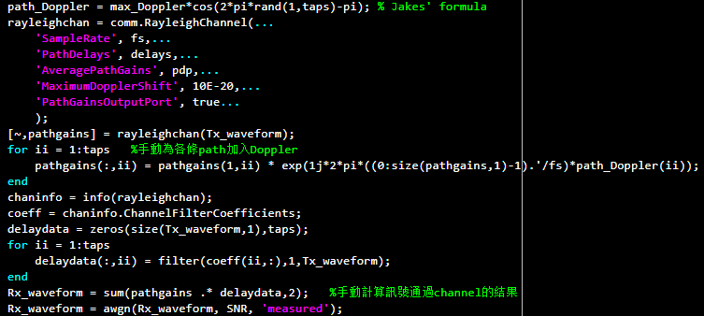
LEO Channel Model for OTFS
Modify the way to add Doppler shift in signal for OTFS modulation.
Because Doppler value changed within an OTFS frame.

Slide 17
Reference
MathWorks Help Center: Get Started with 5G Toolbox https://www.mathworks.com/help/5g/getting-started-with-5g-toolbox.html?s_tid=CRUX_lftnav
3GPP TR 38.811, “Study on New Radio (NR) to support non-terrestrial networks,” V15.1.0, June 2019.
Amit Sravan Bora, Khoa T. Phan, Yi Hong, “Spatially Correlated MIMO-OTFS for LEO Satellite Communication Systems”, 2022 IEEE International Conference on Communications Workshops (ICC Workshops), July 2022.

